Slide 1




Emotion Detection using CNN-LSTM
Project Focus
Presenters
Instructor
Course
Emotion Detection using CNN-LSTM
Noor Fatima (SP23-BAI-046)
Sir Zeeshan Gillani
Artificial Neural Networks
Mubbara Majid (SP23-BAI-027)

Slide 2

Problem Statement: Classifying Text Data
Our primary objective is to classify text into six distinct categories. This addresses a multi-class classification challenge.
This project uses Natural Language Processing (NLP) and Artificial Neural Networks to classify textual data (product reviews) into one of six possible categories. The notebook follows a typical data science pipeline: preprocessing, modeling, evaluation, and visualization.
.
The system needs to accurately assign one of six labels per input text. This is crucial for large-scale text management.

Slide 3
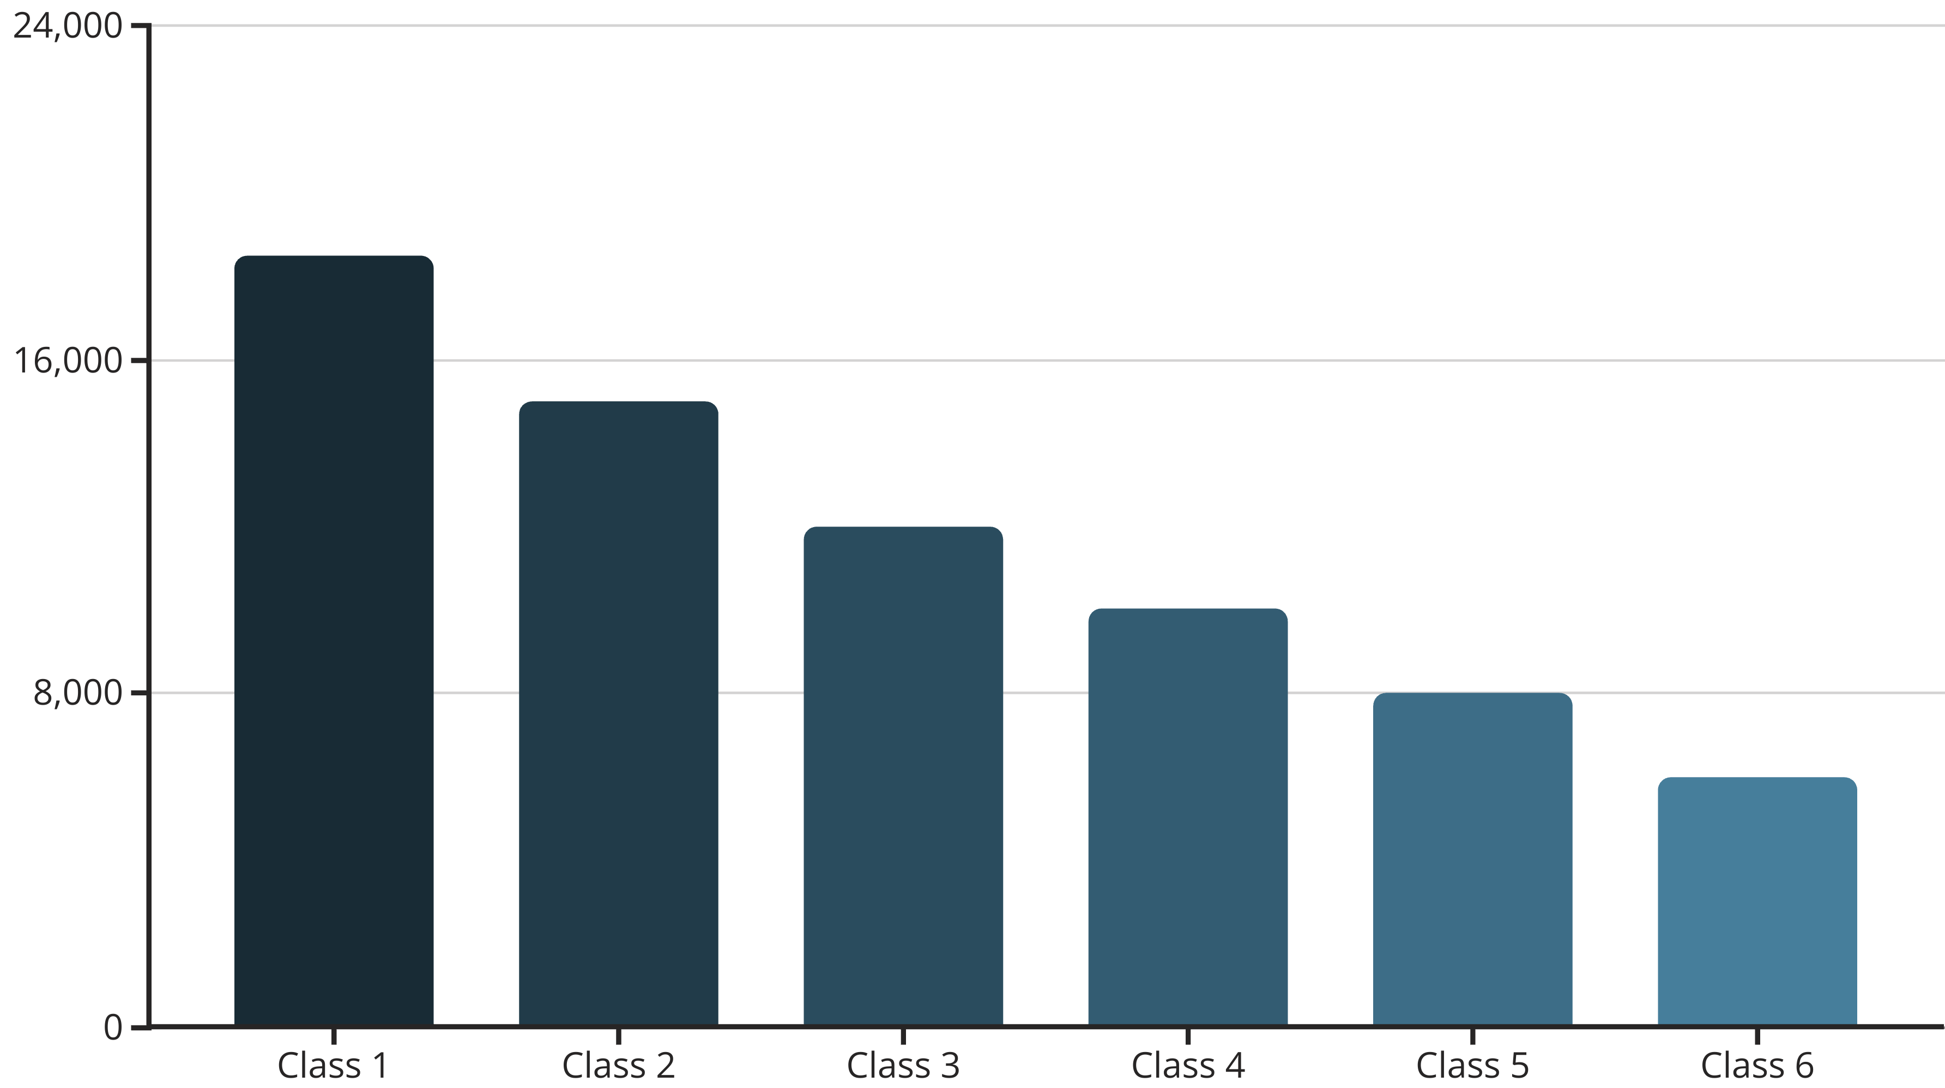
Dataset Overview and Class Distribution
We utilized a .parquet file containing 83,225 labeled text records. The dataset comprises six unique text categories.
Class imbalance was effectively managed. We applied class weighting during model training to ensure fair representation.

Slide 4





Comprehensive Data Preprocessing
Initial Cleaning
Text Normalization
Duplicates and missing values were systematically removed. This ensures data integrity and model reliability.
Text underwent lowercasing and removal of URLs, mentions, hashtags, and punctuation. Stopwords were also eliminated.
Tokenization
Word Embeddings
Keras Tokenizer was used for efficient text tokenization. This prepares the data for numerical representation.
Pre-trained GoogleNews Word2Vec (300-d) provided robust word embeddings. These capture semantic relationships between words.
Each step ensures high-quality input for our deep learning model. This rigorous preprocessing enhances model performance significantly.

Slide 5
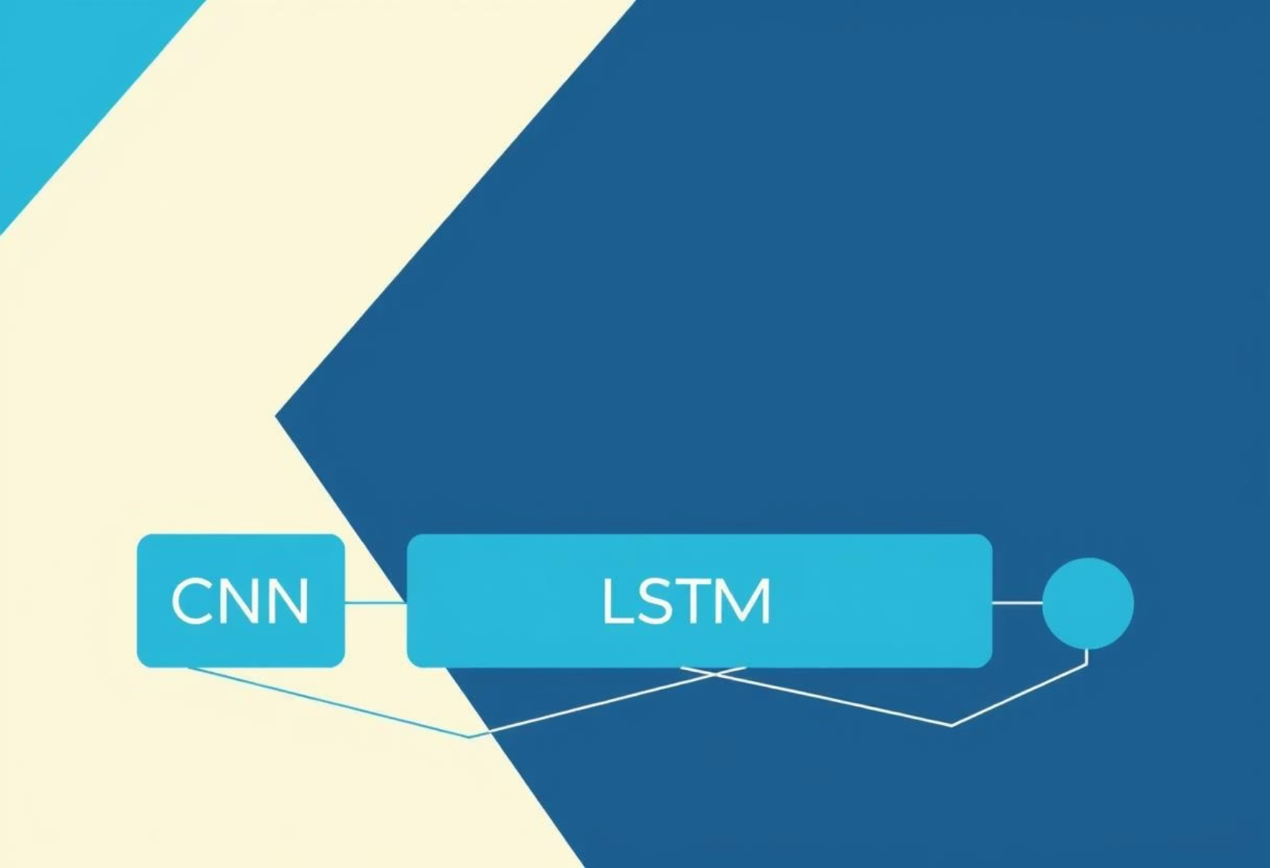
Algorithm Selection and Rationale
Final Chosen Model
Considered Alternatives
The selected model is a combination of CNN and Bidirectional LSTM. It leverages pre-trained Word2Vec embeddings.
We evaluated traditional ML models: Naive Bayes, Logistic Regression, and SVM. They were not chosen due to limitations.
CNN helps the model spot important word patterns.
BiLSTM understands full meaning of the sentence by reading it forward and backward.
Poor handling of sequential/contextual dependencies.
This architecture effectively extracts both local features and sequential dependencies from text. Embeddings enhance generalization.
Required extensive manual feature engineering.
They don’t understand the order or meaning of words.
The chosen deep learning model excels in capturing complex patterns in text. This outperforms simpler machine learning algorithms.

Slide 6
Detailed Model Architecture
Input Layer
Tokenized and padded sequences serve as the initial input. This standardizes input length for the network.
Embedding Layer
A non-trainable Word2Vec embedding layer maps tokens to vectors. This preserves pre-learned semantic relationships.
CNN Block
Conv1D, MaxPooling, and BatchNorm layers extract local features. This identifies patterns within short text segments.
BiLSTM Layers
Bidirectional LSTM layers (64 then 32 units) capture long-range dependencies. They process sequences in both directions.
Output Block
Dense, ReLU, BatchNorm, and Softmax layers finalize processing. The Softmax outputs probabilities for 6 classes.
Adam optimizer with Categorical Crossentropy loss function optimizes the model. This combination ensures efficient learning.

Slide 7
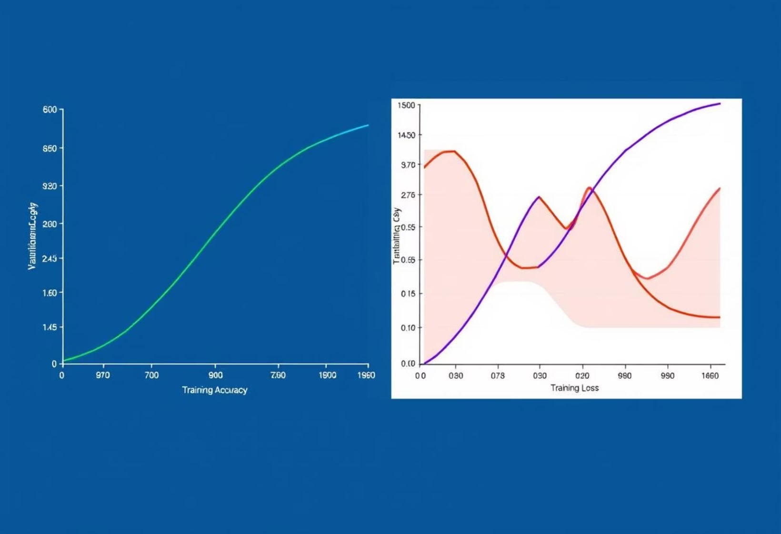
Training and Evaluation Protocol
Training conducted over 10 epochs.
Batch size was set to 128 for efficiency.
Class weights mitigated dataset imbalance.
Accuracy and loss were plotted per epoch.
Monitoring these metrics ensured optimal model performance. It also helped prevent overfitting.
This disciplined approach to training guaranteed robust model development. It led to high accuracy.

Slide 8
Achieved Performance Results
Our model demonstrated exceptional performance across key metrics. These results validate our architectural choices.
93.75%
91.18%
93.92%
Accuracy
Macro F1-Score
Weighted F1-Score
Overall percentage of correct classifications.
Average F1-score across all classes, unweighted.
F1-score weighted by class support, robust metric.
Notably, minority classes, like Class 5, achieved a high recall of 0.995. This indicates effective handling of imbalance.

Slide 9

Advantages of Our Approach
Hybrid Architecture
Combines CNN for local pattern detection and BiLSTM for sequential understanding. This captures diverse text features.
Pre-trained Embeddings
Utilizes Word2Vec embeddings for enhanced semantic understanding. This leverages external linguistic knowledge.
Overfitting Prevention
Dropout and BatchNorm layers prevent overfitting effectively. They improve model generalization on unseen data.
Superior Performance
Significantly outperforms traditional machine learning models. It excels in handling complex textual data.
Our methodology provides a robust and efficient solution. It is ideal for complex multi-class text classification tasks.

Slide 10
Conclusion and Future Scope
We successfully developed a high-performing text classifier. The integration of preprocessing and model selection was critical.
Explore transformer models (e.g., BERT) for richer representations.
Fine-tune existing embeddings for domain-specific contexts.
Develop a robust web API for real-time model deployment.
These future steps will enhance model capabilities and accessibility. They will ensure continued innovation in text classification.

